Slide 1
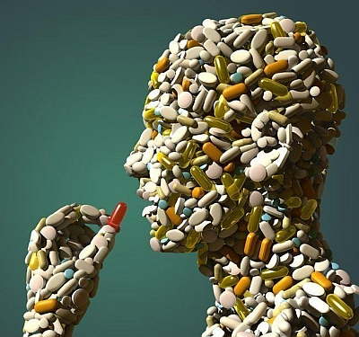
Medicalization Week 7

Slide 2
Lecture outline
What is medicalisation?
History of the concept
Why does medicalisation occur?
What are the consequences of medicalisation?

Slide 3
What do you think?
What products are advertised with a 'healthy' label? How healthy do you think they really are?

Slide 4

Some activities
What products are advertised with a 'healthy' label? How healthy do you think they really are?
What makes you ill? Has it always? Do we focus on things now that we never used to do?
Can medicine solve all problems? There's an app for that! How many things can be cured by taking a 'pill'?

Slide 5
Disease or non disease?

Slide 6
Dengue fever
Ageing
Baldness
Hangover
Jet lag
Road rage
Hypertension
Ignorance
Loneliness

Slide 7
How do you define a disease?

Slide 8
BMJ
The BMJ conducted a survey on the web to identify “non-diseases”—and found almost 200
The notion of “disease” is a slippery one and the concept of non-disease is therefore similarly blurred
Health is equally impossible to define
BMJ. 2002 April 13; 324(7342): 883–885

Slide 9
Are there any good things about having a disease??!!

Slide 10
To have your condition labelled as a disease may bring considerable benefit—both material (financial) and emotional
However, the diagnosis of a disease may also create problems—you may be denied insurance, a mortgage, and employment
A diagnosis may also lead you to regard yourself as forever flawed and unable to “rise above” your problem

Slide 11
Some definitions
I. Zola (1972) Turning of ‘problems of living’ into medical concerns. The labels ‘healthy’ and ‘ill’ are attached to an ever-increasing part of human existence.
R. Nye (2003:115) The ‘tendency to portray social and psychological phenomena as medical problems’. That is, aspects of life that did not used to come under the auspices of medicine are increasing doing so.

Slide 12
Some definitions
A. Clarke et al (2003:161) ‘medicalisation – defined as the processes through which aspects of life previously outside the jurisdiction of medicine some to be construed as medical problems – is one of the most potent social transformations of the last half of the twentieth-century in the west’.

Slide 13
History of the concept
First focus was the medicalisation of deviance (1960s and 1970s)
Since 1980s more of a focus on the development of new medical categories.
And on medicalisation of problems of life/living (e.g sleep, birth, death)
e.g body dysmorphic disorder
In very recent years a focus also on biomedical enhancement.

Slide 14
Why does medicalisation occur? What are its drivers?
In early discussion, was seen mainly due to imperialism on part of medical profession.
Then attention given to patients/consumers as drivers of the process
More recently, emphasis on commercial and market drivers. In his recent work, Conrad refers to
i) biotechnology, ii) consumers, iii) managed care
Now also emphasis on processes of ‘de-medicalisation’
Clarke et al refer to ‘biomedicalization’ (instead of medicalisation)

Slide 15
Consequences? The ‘brighter’ and ‘darker’ side of medicalisation
‘Brighter’
Humanitarian aspects
Treatments where they once were none
‘Darker’
Medicine is not always morally neutral
Other voices may be silenced?
Normalisation
Individualisation of social problems?

Slide 16

Who do you think is writing here?

Slide 17
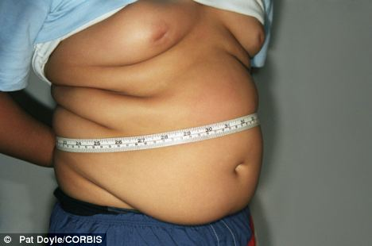
Fat Britain: Tackling the obesity epidemic
‘NHS tells furious mother 'We won't send your schoolboy son to fat camp (but we WILL give him a £7,000 gastric band)' http://www.dailymail.co.uk/news/article-1315575/NHS-wont-send-schoolboy-fat-camp-WILL-7k-gastric -band.html#ixzz110YH3Np9
“Overweight Britons are among the fattest in Europe”
http://www.dailymail.co.uk/health/article-416323/Overweight-Britons-fattest-Europe.html#ixzz110WGqVxd
Increasing numbers of children are being offered gastric band surgery: From zero in 2005 the number of procedures performed on under 18s leapt to more than 13 in 2009 (MailOnline, 2010, 27th September).

Slide 18
E.g Medicalisation of reproduction
Medicalisation of childbirth, menopause
Medicalisation of infertility, new technologies
pros and cons
can exacerbate inequalities (social class, global context)
https://www.youtube.com/watch?v=CNfsnDKnVsQ

Slide 19
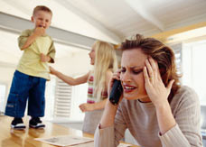
Daily Mail Feb: “Too busy to eat, the working mothers with 'stressorexia‘”
“Stressorexia' is occurring in older, motivated and intelligent women who have trouble handling their workload”

Slide 20
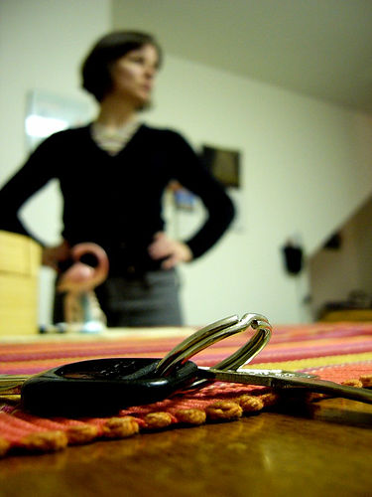
‘Mumnesia’ is a medical fact, say scientists Daily Telegraph March 2008
“Forgetful new mothers can blame their loss of memory on the arrival of their children, according to scientists. For generations, many new mothers have noticed small lapses of memory such as struggling with names, misplacing things or forgetting what they are looking for.
Now neuroscientists and psychiatrists have reported that rather than being merely an old wives' tale, the phenomenon of "mumnesia" is based on medical fact. A combination of fatigue, hormonal changes and stress can all contribute to a loss of memory ”

Slide 21
Additional references
Zola, I. (1975) ‘Medicine as an institution of social control’, Sociological Review 20: 487-504.
Conrad, P. and Schneider, J. (1980) Deviance and Medicalization. From Badness to Sickness. C. V. Mosby Co.
Chesler, P. (1990) Sacred Bond: the legacy of baby M. Virago.
Scott, S. (2006) ‘The medicalisation of shyness: from social misfits to social fitness’, Sociology of Health & Illness, 28 (2): 133-153.
Riessman, C. K. (1983) ‘women and medicalisation: a new perspective’, Social Policy, 14: 3-18.
Rosenfield,D & Faircloth, C ( 2006) ‘Medicalized masculinities’. Temple University Press. Philadelphia.
Gupta, J. A. (2006) ‘Towards transnational feminisms. Some reflections and concerns in relation to the globalisation of reproductive technologies’, European Journal of Women’s Studies, 13 (1): 23-38.

